Slide 1
Google play store apps and review
Lakhvir Singh

Slide 2
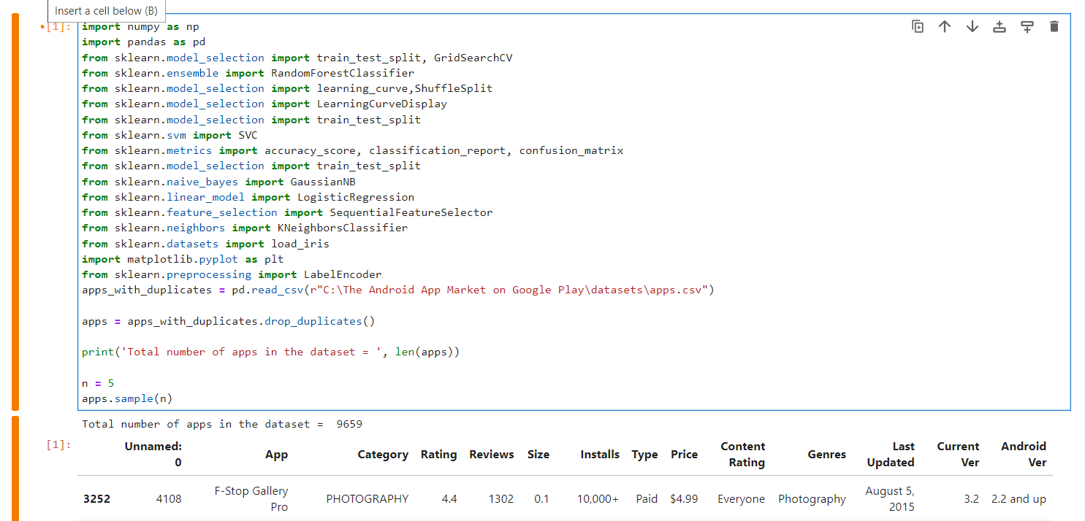
Dataset and Libraries

Slide 3
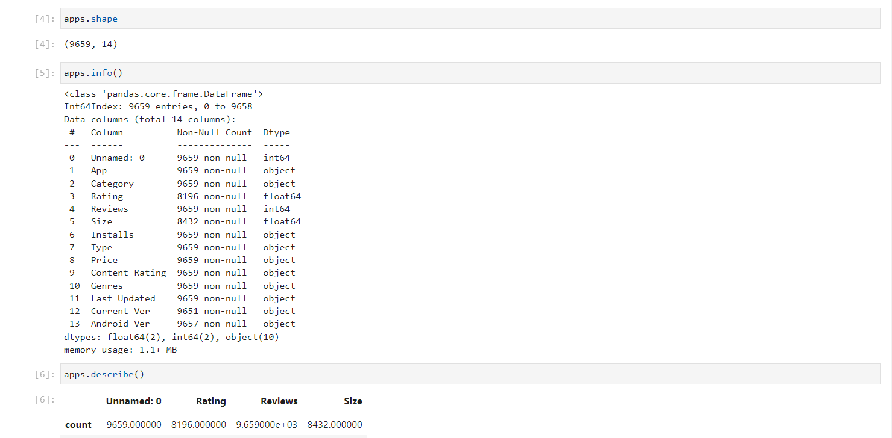
Exploratory data analysis

Slide 4
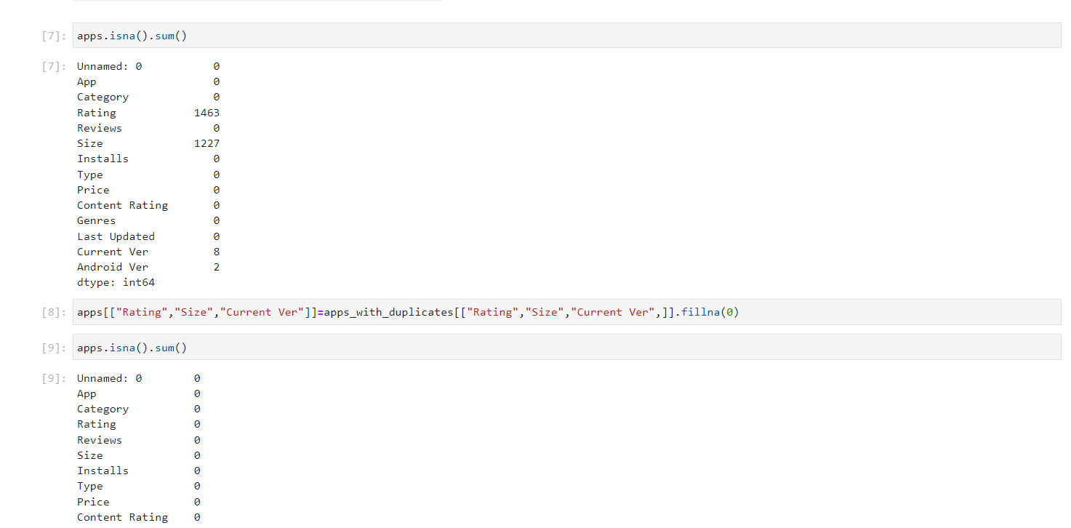
Removing null values

Slide 5
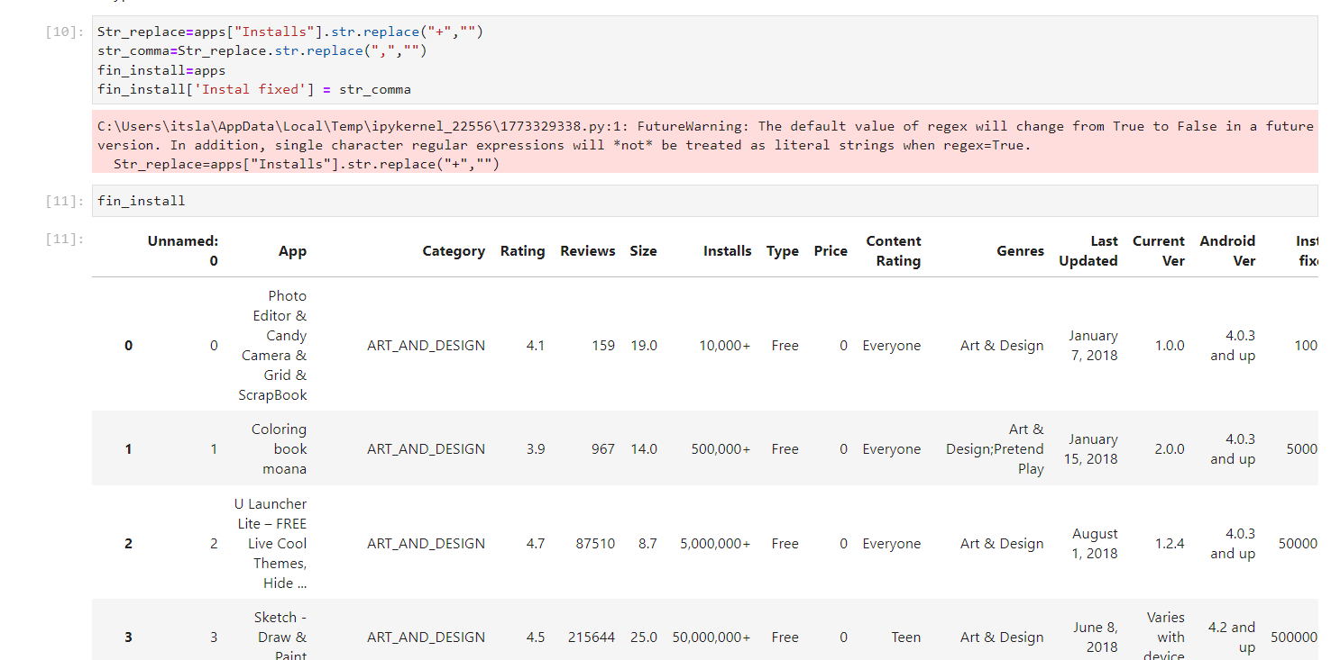
Removing unnecessary characters

Slide 6
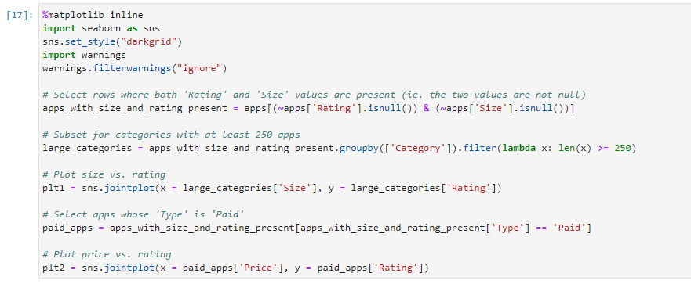
Size and Price of an app

Slide 7
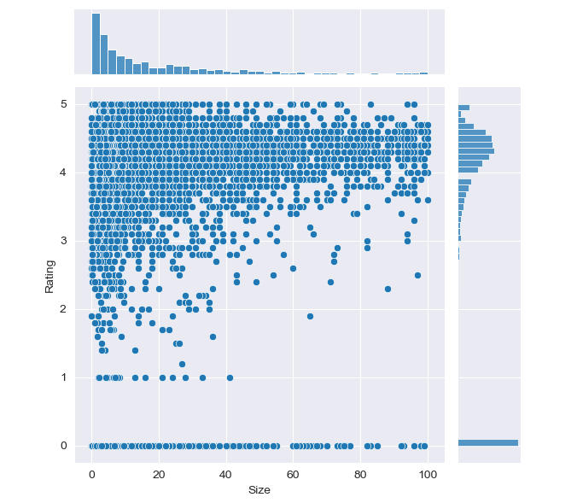
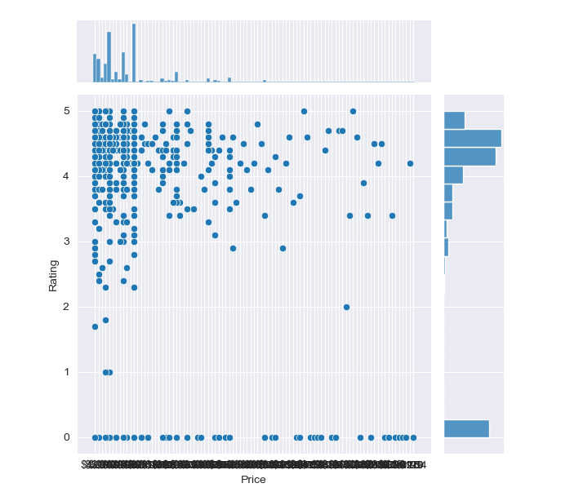

Slide 8
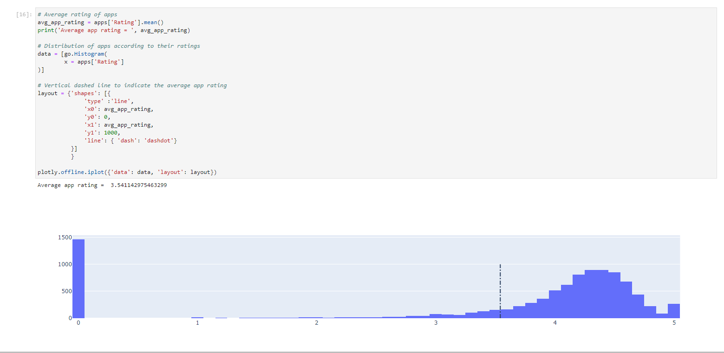
Average rating of apps on play store

Slide 9
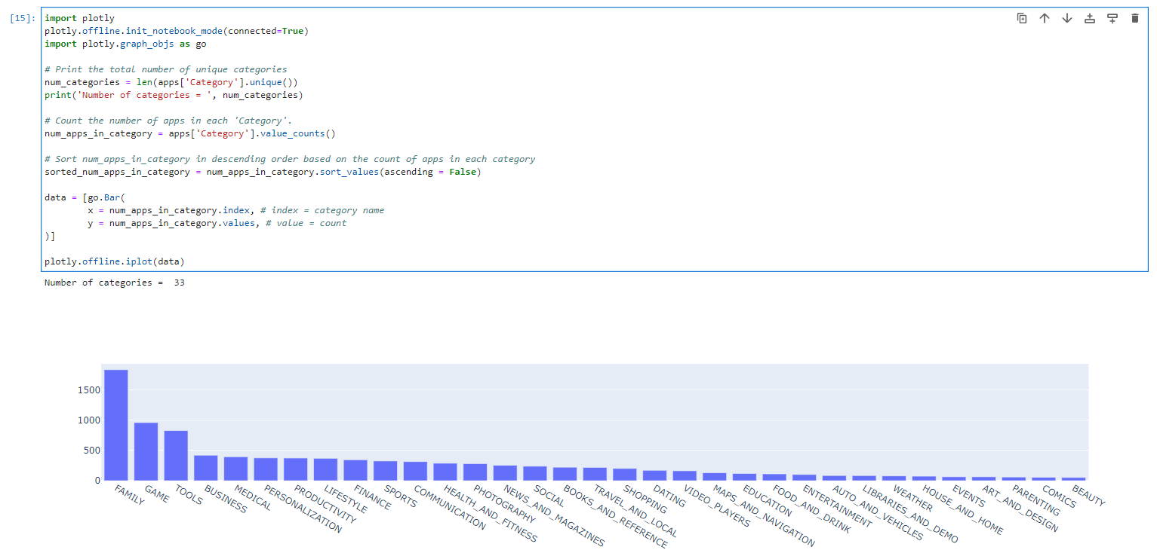
Number of apps category

Slide 10
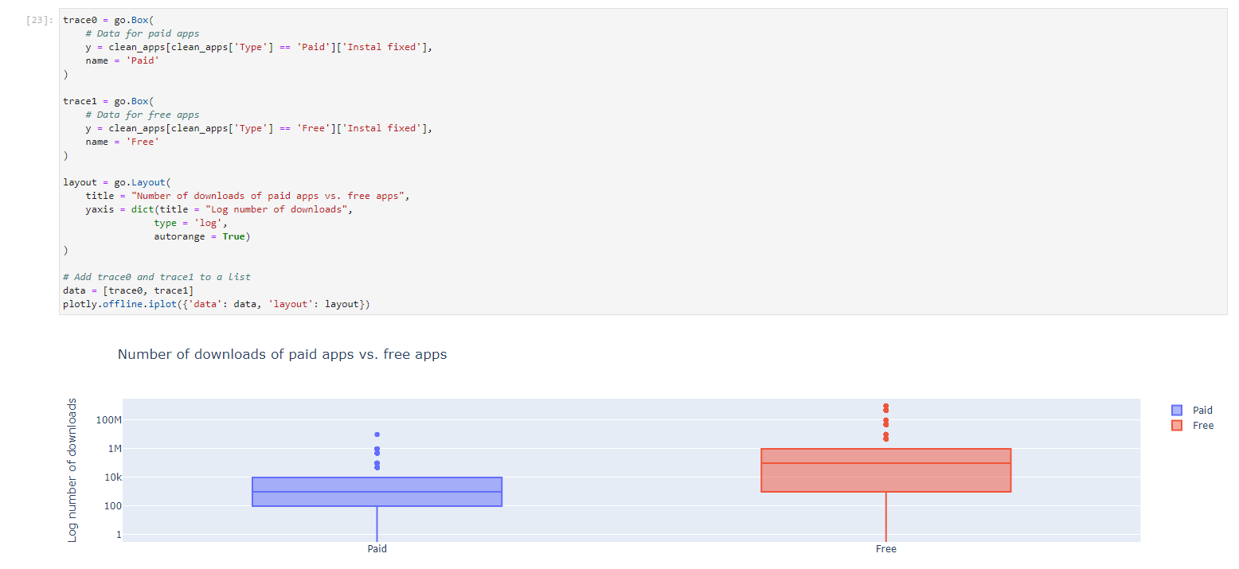
Number of downloads of paid vs free apps

Slide 11
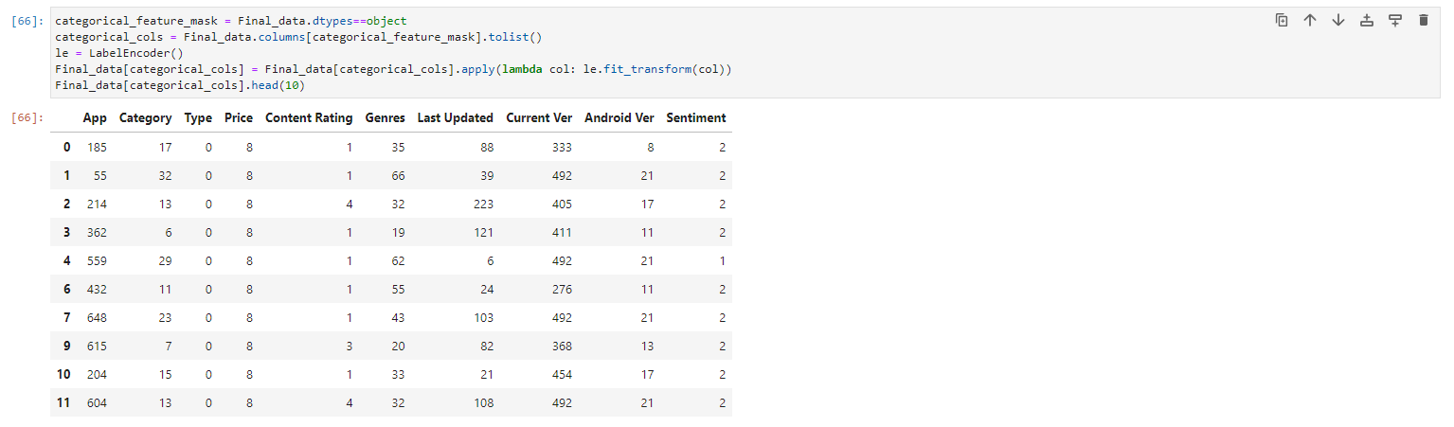
Encoding values

Slide 12
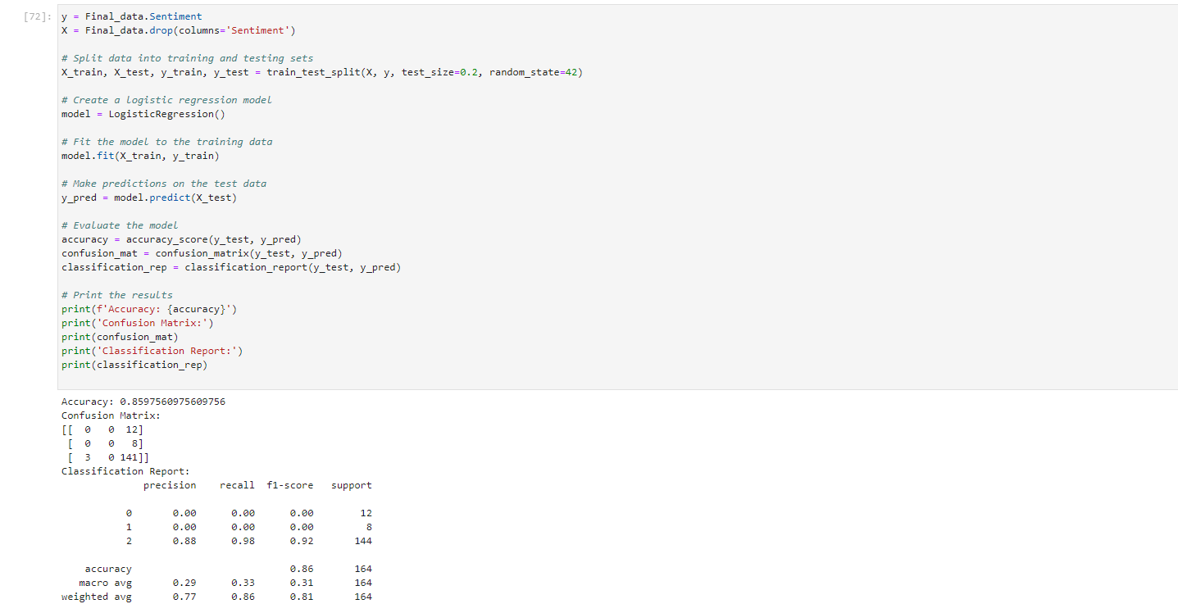
Logistic Regression:

Slide 13
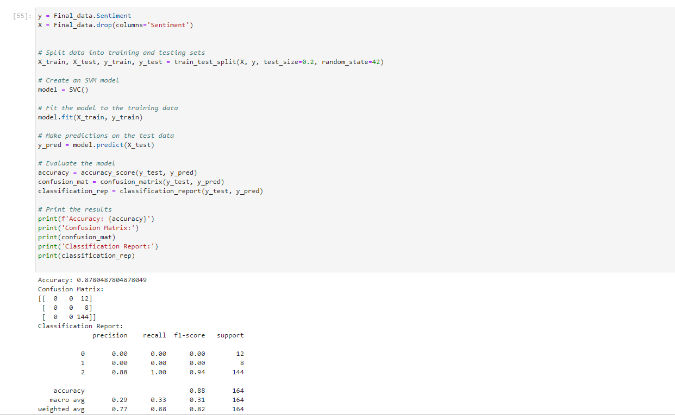
SVC:

Slide 14
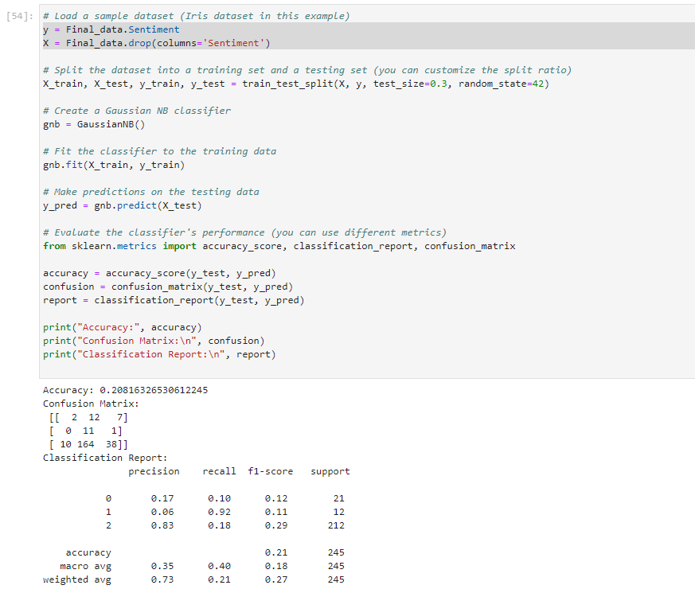
Gaussian naïve bayes:

Slide 15
Lazy Predict:
Lazy predict is a powerful Python library that can help you achieve better results with your machine-learning models. It provides you with a convenient way to pre-process your data, tune your models, and evaluate your results.

Slide 16
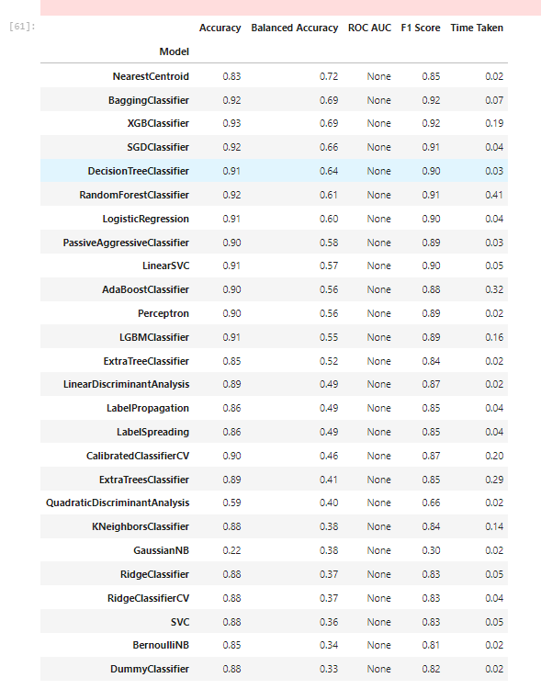
Lazy predict results:

Slide 17
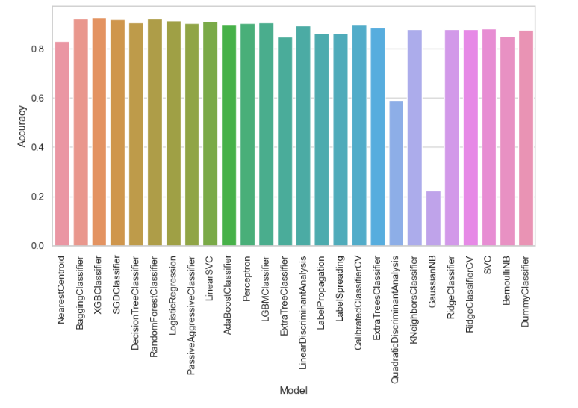
Accuracy Chart:

Slide 18
Thank You

